Slide 1
Struktur Web Dugong Bookstore
Kelompok 3 :
Cindy Maharani – 535180005
Venezia Valen – 535180028
Ika Chandriyani – 535180034
Florentina Pramita – 535180035
El Primo Gemilang – 535180046

Slide 2
Halaman Index
https://dugongbookstore.herokuapp.com/
Header - EJS Layout
Link
Modal
Main – EJS Pages(Index)
Carousel
Redirect to /promo (Individually)
Button Promo Redirect to /promo
Container Best Seller – Auto deploy from List, max 5
Card
Card
Card
Image
Image
Image
Newsletter
Form input Submit to /news
Button Submit
Footer – EJS Layout
Modal

Slide 3
Halaman Index
//Newsletter
router.post('/email', (req,res)=>{
//Get email
const newsLetter = req.body.newsLetter;
//Connect to DB
MongoClient.connect(dbURL, function(err,client){
if (err){
throw err;
}
let db = client.db(dbName);
//Function to FIND DATA
db.collection("emails").find({email: newsLetter}).toArray((err,arr)=>{
if (err) throw err;
else if (arr.length === 0){
//Function to push ONE DATA
db.collection("emails").insertOne({ email: newsLetter},(err,db)=>{
if (err) throw err;
req.flash('emailOK','Sukses terdaftar!');
res.redirect('/#news');
})
} else {
req.flash('emailError','Email yang dimasukkan sudah terdaftar!');
res.redirect('/#news');
console.log("405 - Email Exist"); //Confirmation if NOT OK to push
}
});
});
});
//Main Menu
router.get('/',async(req,res)=>{
//Show to main menu
MongoClient.connect(dbURL, function(err,client){
if (err){
throw err;
}
//Function to read ALL DATA
let db = client.db(dbName);
db.collection("book")
.find({rec: true}).limit(5)
.toArray((err,data)=>{
if (err) throw err;
res.render('pages/index', {recom: data})
})
});
});

Slide 4
Halaman Promo
<div id="promo2"></div>
<div class="promo jumbotron-fluid">
<marquee behavior="alternate"><h1>PROMO DUGONG BOOKSTORE - DESEMBER 2020</h1></marquee>
<div class="container">
<img src="/public/img/promo2.jpg" alt="" width="70%">
<div class="snk">
** Syarat & Ketentuan : <br>
<ul>
<li>Selama persediaan masih ada (100 dugong/hari)</li>
<li>Berlaku untuk 1x transaksi dalam 1 struk</li>
<li>Tidak berlaku kelipatan </li>
<li>Tidak dapat digabungkan dengan promo lain </li>
<li>Periode 01-31 Desember 2020</li>
</ul>
</div>
</div>
<div id="promo1"></div>
<div class="container">
<img src="/public/img/promo1.jpg" alt="" width="70%">
<div class="snk">
** Syarat & Ketentuan : <br>
<ul>
<li>Berlaku untuk 1x transaksi dalam 1 struk</li>
<li>Tidak dapat digabungkan dengan promo lain</li>
<li>Khusus buku terbitan Dugong Bookstore</li>
<li>Periode 01-31 Desember 2020</li>
</ul>
</div>
</div>
<div id="promo3"></div>
<div class="container">
<img src="/public/img/promo3.png" alt="" width="90%">
<div class="snk">
** Syarat & Ketentuan : <br>
<ul>
<li>Maksimal diskon hingga Rp. 100.000,00</li>
<li>Tidak dapat digabungkan dengan promo lain </li>
<li>Periode 11-26 Desember 2020</li>
</ul>
</div>
</div>
</div>
<%- contentFor('title') %>
Promo Dugong
https://dugongbookstore.herokuapp.com/promo
Header – EJS Layout
Link
Modal
Main – EJS Pages (promo)
Marquee
Jumbotron
Container
Image
Unordered List
Container
Image
Unordered List
Container
Image
Unordered List
router.get('/',async(req,res)=>{
//Show to promo
res.render('pages/promo');
});
Footer – EJS Layout
Modal

Slide 5
Halaman Komik dan Novel
Komik – https://dugongbookstore.herokuapp.com/komik Novel – https://dugongbookstore.herokuapp.com/novel
Header – EJS Layout
Link
Modal
<!-- Lokal -->
<div id="lokal"><br></div>
<div class="container my-5">
<h1>Lokal</h1>
<div class="row">
<% if (!novel.length==0) { %>
<% novel.forEach((novel) => { %>
<% if (novel.Status === "lokal") {%>
<div class="card_book mx-auto my-4">
<div class="card_book_main">
<div class="card_book_front">
<img src="public/<%= novel.cover %>">
</div>
<div class="card_book_back">
<h2 class="my-auto py-4" style="font-size: 27px;"><%- novel.Judul %></h2>
<p class="my-auto p-2">Author : <%- novel.Author %></p>
<p class="my-auto p-2">Tahun : <%- novel.Tahun %></p>
<p class="my-auto p-2">ISBN : <%- novel.ISBN %></p>
<p class="my-auto p-2">Lokasi : <%- novel.Pos %></p>
<p class="my-auto p-2">Stock : <%- novel.Stok %></p>
<!-- ---------- -->
<form action="public/<%= novel.ISBN %>" method="GET">
<button type="submit" class="btn btn-outline-secondary">Details</button>
</form>
</div>
</div>
</div>
<% } %>
<% }) %>
<% } else { %>
<h4>Tidak!</h4>
<% } %>
</div>
</div>
<%- contentFor('title') %>
Novel
Main – EJS Pages(Independent Komik / Novel)
Lokal Auto deploy if status = lokal
Container – EJS Pages
Card_Front
Card_Back
Image
Image
Headings
Paragraph
Impor Auto deploy if status = impor
Card_Front
Card_Back
Image
Image
Headings
Paragraph
Footer – EJS Layout
Modal

Slide 6
router.get('/novel', async(req,res)=>{
//Show to novel
MongoClient.connect(dbURL, function(err,client){
if (err){
throw err;
}
//Function to read ALL DATA
let db = client.db(dbName);
db.collection("book")
.find({ Type: "novel" })
.toArray((err,data)=>{
if (err) throw err;
res.render('pages/novel', {novel: data});
})
});
});
router.get('/komik', async(req,res)=>{
//Show to novel
MongoClient.connect(dbURL, function(err,client){
if (err){
throw err;
}
//Function to read ALL DATA
let db = client.db(dbName);
db.collection("book")
.find({ Type: "komik" })
.toArray((err,data)=>{
if (err) throw err;
res.render('pages/komik', {komik: data});
})
});
});

Slide 7
Halaman Details
<% detail.forEach((detail) => { %>
<div class="det">
<div class="judul my-5">
<h3><%= detail.Judul %></h3>
</div>
<div class="row">
<div class="col-lg-3 text-center mx-5">
<img src="<%= detail.cover %>" alt="fer" class="w-100">
</div>
<div class="col my-3">
<h4>Details</h4>
<pre>
<b>Judul</b> : <%= detail.Judul %>
<b>Author</b> : <%= detail.Author %>
<b>Tahun</b> : <%= detail.Tahun %>
<b>ISBN</b> : <%= detail.ISBN %>
<b>Lokasi</b> : <%= detail.Pos %>
<b>Stok</b> : <%= detail.Stok %>
</pre>
</div>
</div> <hr>
<div class="row mt-5 w-75 mx-5">
<h4>Sinopsis</h4>
</div>
<div class="row w-75 mx-auto">
<p><%= detail.sinopsis %></p>
</div> <hr>
</div>
<% }) %>
Header – EJS Layout
Link
Modal
Main – EJS Pages (details) -> Dynamic
Headings
Image
Pre
Headings
router.get('/', async(req, res) => {
const isbn = req.params.ISBN;
MongoClient.connect(dbURL, (err, book) => {
if (err) {
throw err;
}
let db = book.db(dbName);
db.collection("book").find({ISBN: isbn}).toArray((err, data) => {
if (err) throw err;
res.render('pages/details', {det: data});
})
});
});
Paragraph
Footer – EJS Layout
Modal

Slide 8
Halaman Search
<div id="searcharea">
<label for="search">Search Books</label>
<p>Input Judul atau Author atau Tahun Terbit atau ISBN</p>
<form action="/result" method="POST" class="form-inline justify-content-center">
<input type="text" name="sBox" placeholder="Judul / Author / Tahun / ISBN" required>
<input type="submit" class="btn btn-primary sd-3" name="submit" value="Search">
</form>
</div>
<div class="container">
<br>
<% if (!sRes.length==0) { %>
<% sRes.forEach((sRes) => { %>
<div class="card_book mx-auto my-4">
<div class="card_book_main">
<div class="card_book_front">
<img src="public/<%= sRes.cover %>">
</div>
<div class="card_book_back">
<h2 class="my-auto py-4" style="font-size: 27px;"><%- sRes.Judul %></h2>
<p class="my-auto p-2">Author : <%- sRes.Author %></p>
<p class="my-auto p-2">Tahun : <%- sRes.Tahun %></p>
<p class="my-auto p-2">ISBN : <%- sRes.ISBN %></p>
<p class="my-auto p-2">Lokasi : <%- sRes.Pos %></p>
<p class="my-auto p-2">Stock : <%- sRes.Stok %></p>
<!-- ---------- -->
<form action="public/<%= sRes.ISBN %>" method="GET">
<button type="submit" class="btn btn-outline-secondary">Details</button>
</form>
</div>
</div>
</div>
<% }) %>
<% } else { %>
<span class="text-light pl-2"><b>Ayo Cari Buku Mu!</b></span>
<% } %>
</div>
<%- contentFor('title') %>
Search
https://dugongbookstore.herokuapp.com/search
Header – EJS Layout
Link
Modal
Main – EJS Pages (search)
Label
Input Judul, Author, ISBN, Tahun
Search
Card_front
Card_back
Headings
Image
Paragraph
Link
Footer – EJS Layout
Modal

Slide 9
router.get('/search', async(req,res)=>{
res.render('pages/search', { sRes: []});
})
router.post('/result', (req,res)=>{
//Get the query
var target = req.body.sBox.toString();
//Connect to DB
MongoClient.connect(dbURL, function(err,client){
if (err){
throw err;
}
let db = client.db(dbName);
//Function to FIND DATA
db.collection("book").find(
{$or:[{Judul: new RegExp(target, 'i')},{Author: new RegExp(target, 'i')},{Tahun: new RegExp(target, 'i')},{ISBN: new RegExp(target, 'i')}]}
).toArray((err,arr)=>{
if (err) throw err;
if (arr.length === 0){
//return NOT FOUND
res.render('pages/search',{msgError: "Buku tidak dapat ditemukan :("});
console.log("404 - Book no found");
}
else {
//return FOUND BOOK
res.render('pages/search',{sRes: arr} );
}
});
});
});

Slide 10
Halaman Admin Login
<nav class="navbar navbar-expand-lg navbar-dark fixed-top">
<a class="navbar-brand" href="/">
<img id="logo" src="/public/img/logodugong.png" alt="Logo">
</a>
<h5 style="color: white;">Dugong Bookstore</h5>
</nav>
https://dugongbookstore.herokuapp.com/me7rhg/login
Main – EJS Pages (Adminlogin)
Link
<div class="container-md mt-3">
<div class="cardadm">
<div class="card-body">
<h1 class="card-title text-center">Admin Login</h1> <hr>
<form action="/me7rhg/login" method="post">
<div class="form-group">
<label for="username">Username</label>
<input type="text" class="form-control" name="username" required autofocus>
</div>
<div class="form-group">
<label for="password">Password</label>
<input type="password" class="form-control" name="password" required>
</div>
<input type="submit" class="btn btn-success" name="submit" value="Login">
<% if (locals.error) { %>
<span class="text-danger pl-2"><%= error %></span>
<% } %>
</form>
</div>
</div>
</div>
Admin Login
Username
Password
Login
Wrong username or password!

Slide 11
//Login Progress
router.post('/login', async (req, res) => {
// get user input
const username = req.body.username;
const password = req.body.password;
if(username === "dugong"){
member.find({"username": username}).exec((error, data) => {
if (error) console.log(JSON.stringify(error));
if (data){
bcrypt.compare(password, data[0].password, function(err, isMatch) {
if (err) {
throw err;
} else if (!isMatch) {
console.log("401 - Not Authorized");
res.render('pages/adminlogin', { layout: false, error: 'Wrong username or password!' } );
} else {
req.session.user = username;
res.redirect('/list');
}
})
}
});
}else{
console.log("401 - Not Authorized");
res.render('pages/adminlogin', { layout: false, error: 'Wrong username or password!' } );
}
});
//Login - Force
router.get('/login', async (req, res) => {
if (req.session.user) {
res.redirect('/');
} else {
res.render('pages/adminlogin', { layout: false });
}
});
//Logout
router.get('/logout', async (req, res) => {
req.session.destroy();
res.redirect('/me7rhg/login');
});

Slide 12
Halaman List
<form action="/me7rhg/logout" method="get" class="">
<input type="submit" class="btn btn-primary float-left" value="Log out">
</form>
<a href="./add" class="btn btn-primary mx-2">Add new book</a>
https://dugongbookstore.herokuapp.com/list
Header – EJS Layout
Link
Modal
<% book.forEach(function (book){ %>
<tr>
<td><%= book.Judul %></td>
<td><%= book.Author %></td>
<td><%= book.Tahun %></td>
<td><%= book.ISBN %> </td>
<td><%= book.Status %></td>
<td>
<form action="list/delete/<%= book.ISBN %>" method="post">
<button type="submit" class="btn btn-secondary my-1">Delete</button>
</form>
<form action="list/edit/<%= book.ISBN %>" method="get">
<button type="submit" class="btn btn-primary my-1">Edit</button>
</form>
<% if (book.rec) {%>
<form action="list/unrec/<%= book.ISBN %>" method="post">
<button type="submit" class="btn btn-primary my-1">Not Recommend</button>
</form>
<%} else {%>
<form action="list/rec/<%= book.ISBN %>" method="post">
<button type="submit" class="btn btn-primary my-1">Recommend</button>
</form>
Main – EJS Pages (Link)
Option
Log Out
Add
Judul Author Tahun ISBN Status Action
Delete
Item #1
Edit
Recommend
Delete
Item #n
Edit
Recommend
Footer – EJS Layout
Modal

Slide 13
//Recommend
router.post('/rec/:isbn', async(req,res)=>{
const isbn = req.params.isbn;
bookModel.updateOne({ISBN: isbn},{rec: true},(err,raw)=>{
bookModel.find({ISBN: isbn}).limit(1).exec((err,data)=>{
if (err) throw err;
res.redirect('/list');
})
})
})
//Not Recommend
router.post('/unrec/:isbn', async(req,res)=>{
const isbn = req.params.isbn;
bookModel.updateOne({ISBN: isbn},{rec: false},(err,raw)=>{
bookModel.find({ISBN: isbn}).limit(1).exec((err,data)=>{
if (err) throw err;
res.redirect('/list');
})
})
})
//Delete
router.post('/delete/:isbn', async(req,res) => {
const isbn = req.params.isbn;
MongoClient.connect(dbURL, function(err,client){
if (err){
throw err;
}
let db = client.db(dbName);
//Function to FIND DATA
db.collection("book").find({ISBN: isbn}).toArray((err,arr)=>{
if (err) throw err;
else if (arr.length === 0){
console.log("404 - No book.");
} else {
db.collection("book").deleteOne({ ISBN: isbn},(err,data)=>{
if (err) throw err;
res.redirect('/list');
})
}
});
});
});
//Edit - get ISBN
router.get('/edit/:isbn', async(req,res)=>{
const isbn = req.params.isbn;
bookModel.find({ISBN: isbn}).limit(1).exec((err,data)=>{
if (err) throw err;
res.render('pages/edit',{book: data});
});
});

Slide 14
Halaman Add/Edit
<form action="/add/list" enctype="multipart/form-data" method="POST">
<div>
<label for="type">Type: </label>
<input type="radio" id="type" name="type" value="komik"/> Komik
<input type="radio" id="type" name="type" value="novel"/> Novel
</div>
<div>
<label for="status">Status: </label>
<input type="radio" id="status" name="status" value="lokal"/> lokal
<input type="radio" id="status" name="status" value="impor"/> impor
</div>
<div>
<label for="name">Title</label>
<input type="text" id="name" placeholder="Title"
value="" name="name" required>
</div>
<div>
<label for="author">Author</label>
<input type="text" id="author" placeholder="Author"
value="" name="author" required>
</div>
<div>
<label for="year">Year</label>
<input type="text" id="year" placeholder="Year" value="" name="year" required>
</div>
<div>
<label for="ISBN">ISBN</label>
<input type="text" id="ISBN" placeholder="ISBN" value="" name="ISBN" required>
</div>
<div>
<label for="lokasi">Lokasi</label>
<input type="text" id="lokasi" placeholder="Lokasi"
value="" name="lokasi" required>
</div>
<div>
<label for="stok">Stok</label>
<input type="number" min="0" id="stok" placeholder="Stok"
value="" name="stok" required>
</div>
<div>
<label for="sinopsis">Sinopsis</label>
<textarea id="sinopsis" style="width: 500px;" name="sinopsis" value=""rows="5" placeholder="Sinopsis" required>
</textarea>
</div>
<div>
<label for="image">Upload Image</label>
<input type="file" id="image" name="book" value="" required>
</div>
<div>
<button type="submit" class="btn btn-primary">Submit</button>
</div>
</form>
https://dugongbookstore.herokuapp.com/add
Header – EJS Layout
Link
Modal
Main – EJS Pages (Individual Add/Edit) -> Dynamic
Add / Edit
Type (Radio Button) Status (Radio Button)
Title
Author
Year
ISBN
Lokasi
Stok
Sinopsis
Upload Image (Button)
Submit
Cancel
Footer – EJS Layout
Modal

Slide 15
router.get('/',async(req,res)=>{
//Show to main menu
res.render('pages/add');
});
router.post('/list', function(req,res){
upload(req, res,(error) => {
if(error){
console.log(error);
}else{
var fullpath = "img/"+req.file.filename;
var obj = {
Status : req.body.status,
Type : req.body.type,
Judul : req.body.name,
Author : req.body.author,
Tahun : req.body.year,
ISBN : req.body.ISBN,
Pos : req.body.lokasi,
Stok : req.body.stok,
cover: fullpath,
sinopsis : req.body.sinopsis,
rec: false
};
const type = req.body.type;
const book = new Book(obj);
book.save(function(err){
if (err) throw err;
// ---------
// res.render('pages/add', {msg : "Success."})
res.redirect('/list')
console.log("Added to DB");
})
}
});
});
//Edit - Post update
router.post('/update', function(req,res){
upload(req,res,(error)=>{
if(error){
console.log(error);
}
else{
var fullpath = req.file.filename;
if (!req.file.filename.includes("img/")) {
var fullpath = "img/"+req.file.filename;
}
else {
fullpath = req.file.filename;
}
Book.updateOne({ISBN: req.body.ISBN},
{Status: req.body.status, Type: req.body.type,
Judul: req.body.name, Author: req.body.author,
Tahun: req.body.year, ISBN: req.body.ISBN,
Pos: req.body.lokasi, Stok: req.body.stok,
cover: fullpath, sinopsis: req.body.sinopsis,
rec: false},(err,raw)=>{
Book.find({ISBN: req.body.ISBN}).limit(1).exec((err,data)=>{
if (data) res.redirect('/list');
});
});
}
})
});

Slide 16
Database Atlas MongoDB
Schema
//Emails const emailSchema = mongoose.Schema({
email: String
},{collection: 'emails'});
//Book var bookSchema = mongoose.Schema({
Status: String,
Type: String,
Judul: String,
Author: String,
Tahun: String,
ISBN: String,
Pos: String,
Stok: Number,
cover: String,
sinopsis: String,
Pos: String,
rec: Boolean
},{
collection: 'book'
});
//Member (Admin) var memberSchema = mongoose.Schema({
username: String,
password: String
},{
collection: 'admin'
});

Slide 17

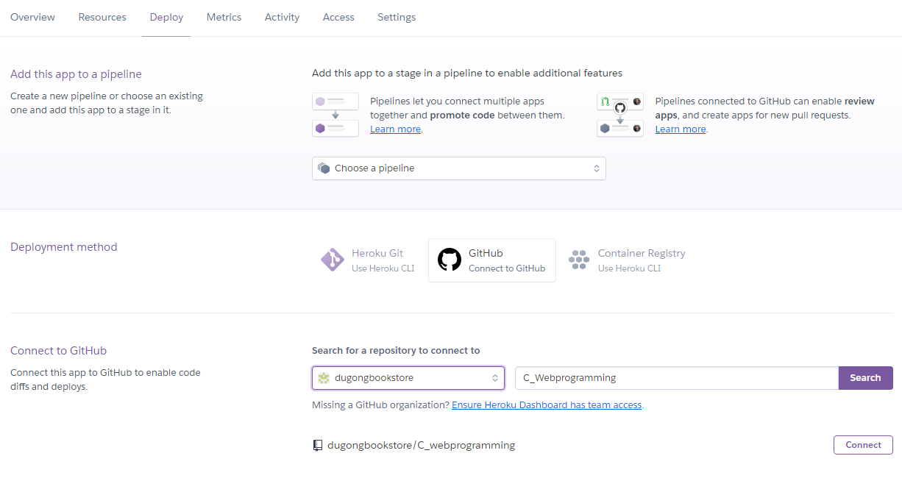
HEROKU Web Server How to deploy
Proses ini dapat dilakukan saat sudah mempunyai akun pada heroku.com .
Pilih New > Create New App
Isi App Name dan pilih Region yang diinginkan. Pilih Create App.
Pilih Deploy > Deployment Method
Pilih GitHub sebagai metode development. Kemudian sambungkan github projek dengan memasukkan Nama Repository project GitHub pada kolom yang tersedia. Pilih Search. Apabila ditemukan, pilih Connect.

Slide 18
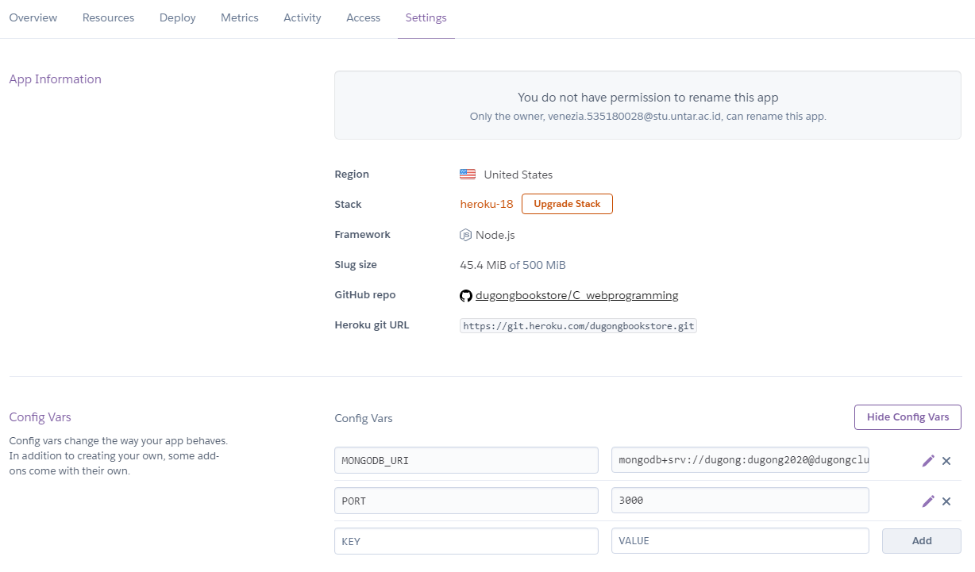
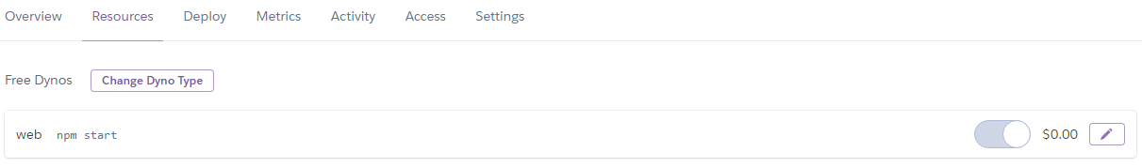
Pilih Setting > Reveal Config Far
Isi MONGODB_URI dengan value URL Cluster MongoDB Atlas yang sudah dibuat. Isi PORT dengan value 3000.
Apabila sudah benar, pilih Add.
Pilih Resource > Free Dynos
Pada bagian ini, isi command untuk menjalankan website
seperti npm start.

Slide 19
Terima kasih
Dugong Bookstore
Information portal for
your book! (Dugong not included)

